Slide 1

MINIPROJECT on CD MANAGEMENT
Presented by: E Vikram 17121a1219
E Adil 17121a1220
E karthik 17121a1221
G Haritha 17121a1228
G Sreekanth 17121a1229
G Chndrakanth 17121a1230

Slide 2
TABLE OF CONTENT
CONTENTS | SLIDE NUMBER
Abstract | 4
Modules | 5
Description on modules | 8
Design of the project | 9
Hardware/Software requirements | 10
Status of the project | 11
Conclusion | 12
References | 13
Result | 14

Slide 3
ABSTRACT
Objective :
This software is basically a CD management software which can be used in a CD’s store. It keeps the record of all the CD’s present in the CD’s store and we can also add more records for the fresh arrivals. This project can search the CD’s available in the store, by various modes like Singer name, CD name.
Requirements :
The three requirements – updating , searching and displaying the data. All the data you need to store is textual.

Slide 4
ABSTRACT
Concepts :
This program uses the concept of shell programming.
Functions
Files
Command with options(i.e., echo –e , track , etc.,)
Control structures
Data files used :
title.cdb , tracks.cdb , temp_file

Slide 5
ANALYSIS
MODULES:
1 : ADDING
2 : MODIFYING
3 : DELETING
4 : SEARCHING
5 : DISPLAYING

Slide 6
MODULES DESCRIPTION
Module 1:
Adding the details of a new CD:
The user enters the track information for this CD, catalog name, title, type and artist or composer.
Module 2:
Modifying the data of an CD:
This allows you to re-enter information for a CD . Notice that you search(using grep ) for lines that start (^)with the $cdcatnum followed by a comma ,and that you need to wrap the expansion of $cdcatnum in {}.

Slide 7
MODULES DESCRIPTION
Module 3:
Deleting a CD details:
This strips entries from the database files, using grep –v to remove all matching strings. Notice that you must use a temprary file(temp_file).
Module 4:
Searching for a CD:
This searches for the catalog name text in the CD title file, using the grep command.

Slide 8
MODULES DESCRIPTION
Module 5:
Displaying the list of all CD’s:
This opens the temporary file reads one by one and then displays all the tracks list .
All the modules uses the data files declared globally.

Slide 9
DESIGN OF THE ROJECT
flowhari.docx

Slide 10
Hardware/Software Requirements
HARDWARE | SOFTWARE
Linux environment | Processor : SoC
Vi editor – Shell programming | RAM : 2 GB -64 bit
 | Hard disk: 20 GB – 64 bit

Slide 11
Status of the project
TASK | PERCENTAGE COMPLETE
Analysis | 100%
Design | 81%
Development | 100%

Slide 12
CONCLUSION
This system provides an easy way for the operator to interact with the database and to manipulate the data in the database.
The operator can add, delete and update the records in the database with ease.
Provide easy, accurate, unambiguous and faster data access.

Slide 13
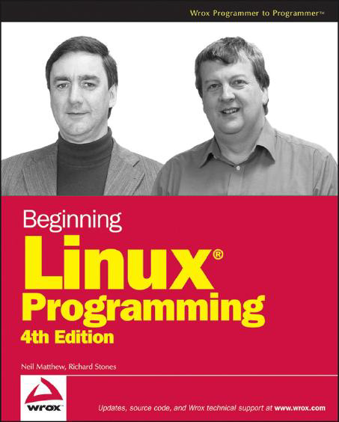
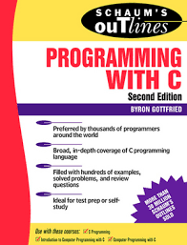
REFERENCES
The project is referred from :
Beginning Linux Programming 4th edition
Nail Matthew, Richard Stones

Slide 14
RESULTS
This system is very simple in design and to implement.
This project main intention is to make task easy for CD database.
Easy handling of huge amount of data regarding CD tracks.

Slide 15
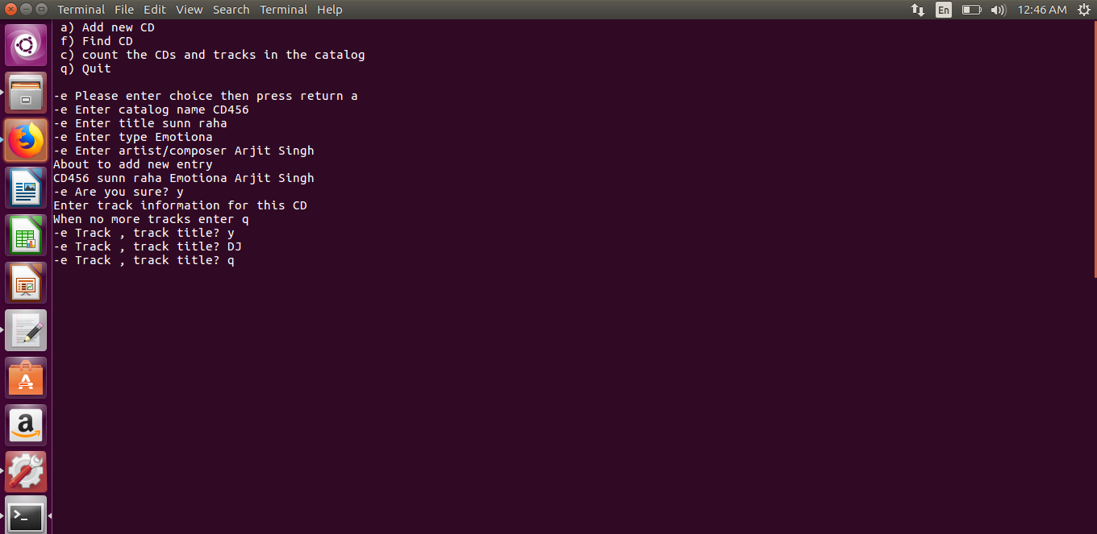
RESULTS

Slide 16
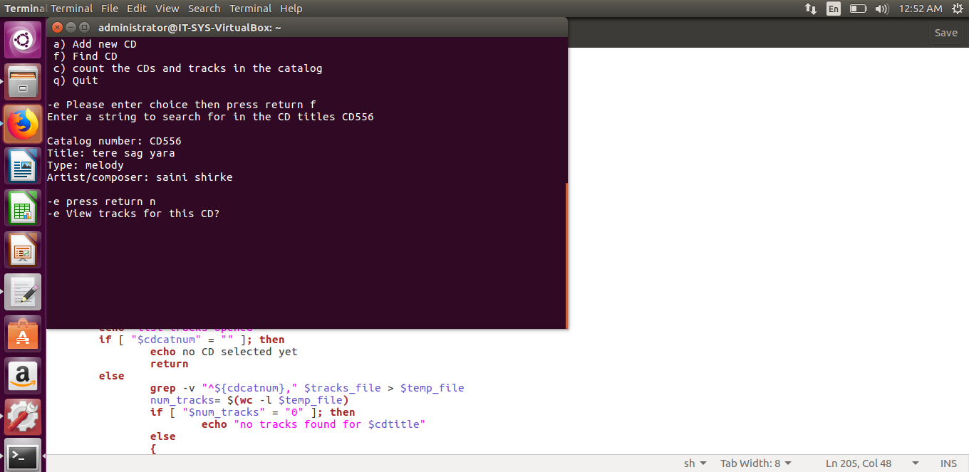
RESULTS

Slide 17
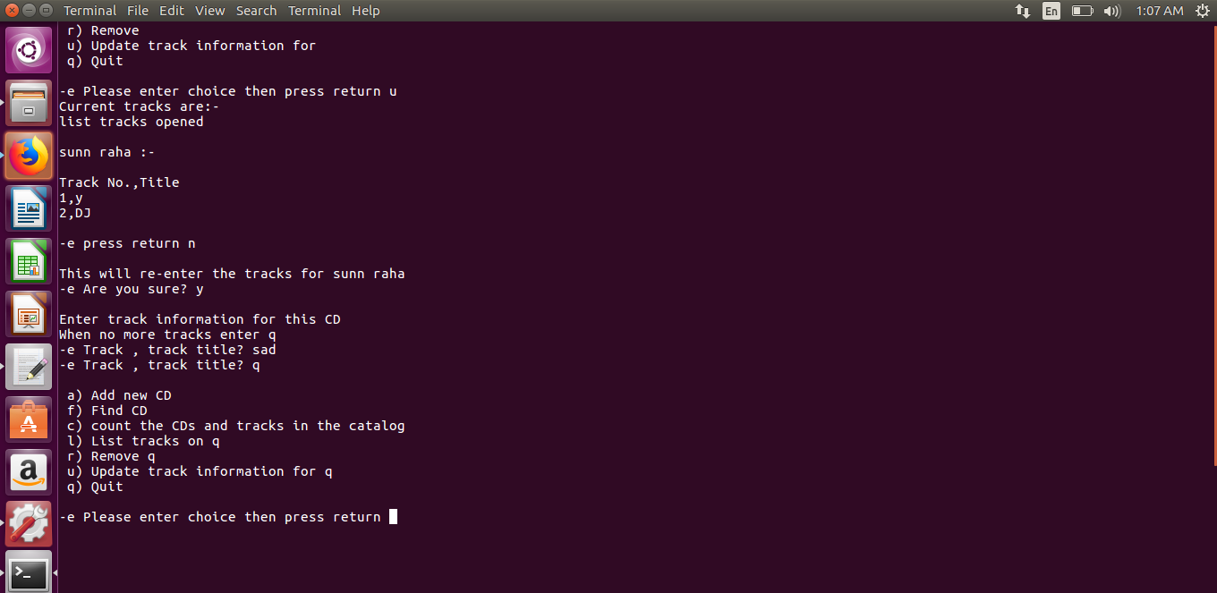
RESULTS

Slide 18

RESULTS

Slide 19
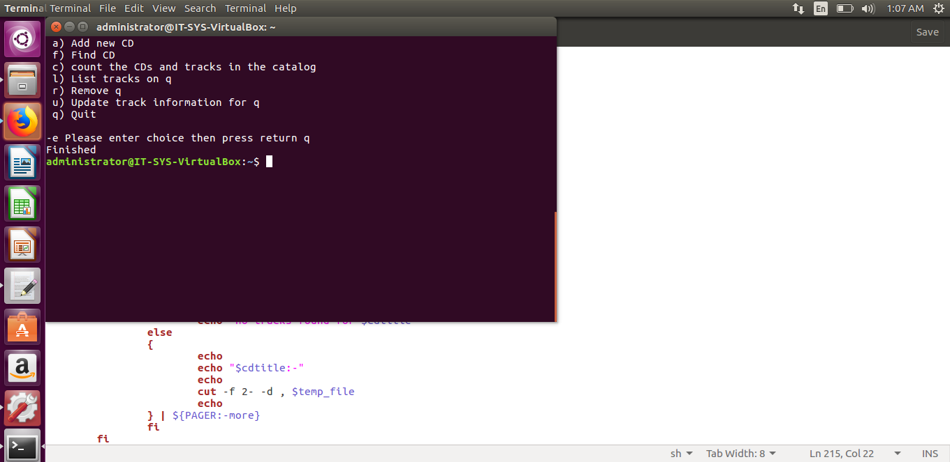
RESULTS

Slide 20


